Slide 1

Who Will Buy Tickets
MIS 665
Changdong Shao
Spring 2018

Slide 2
Overview
What makes people buy tickets or not?
Data Cleaning
Data Visualization
Data analysis
Model Selection
Conclusion

Slide 3
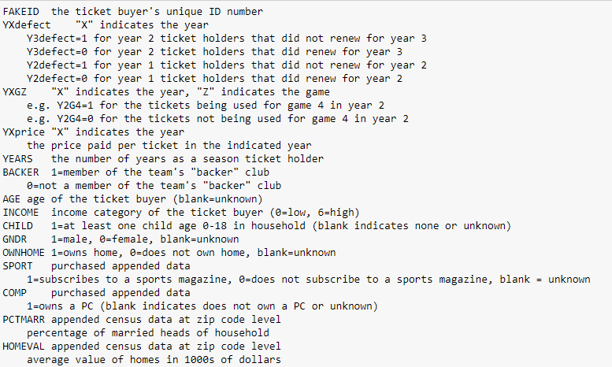
What makes people buy tickets or not?

Slide 4
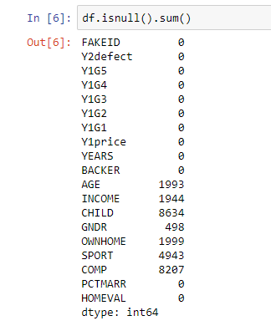
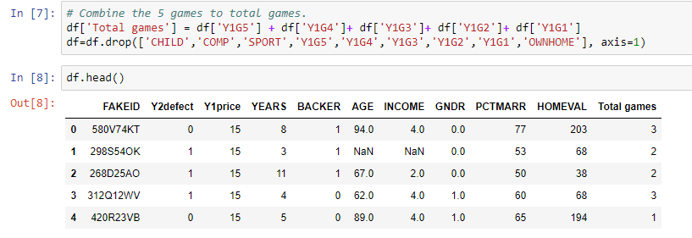
Data Cleaning

Slide 5
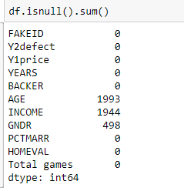
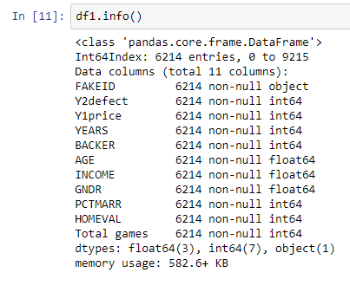
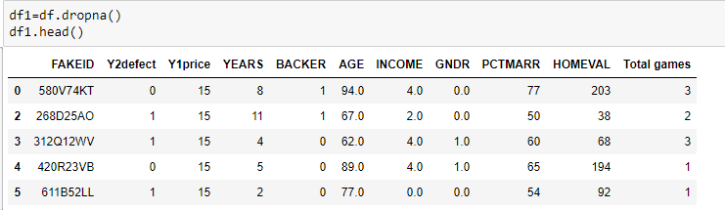
Data Cleaning

Slide 6
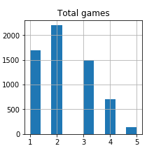
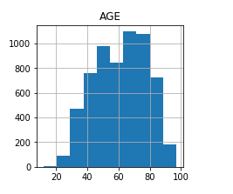
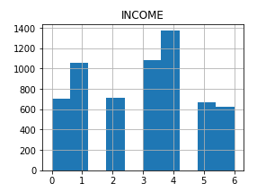
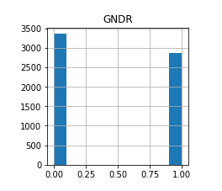
Data Visualization

Slide 7
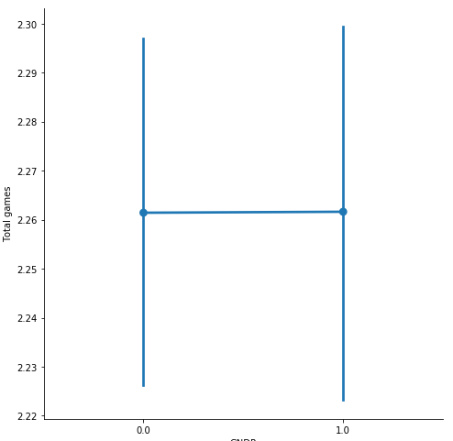
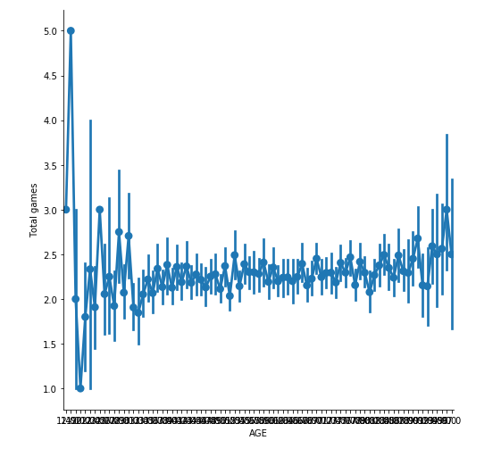
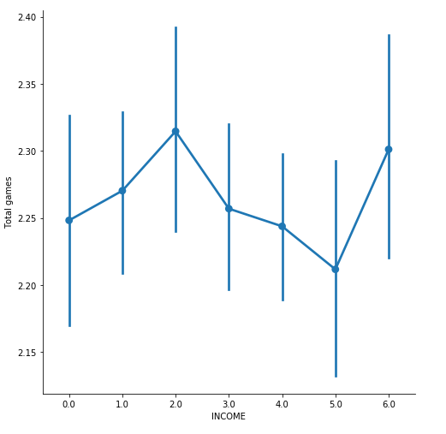
Data Visualization

Slide 8
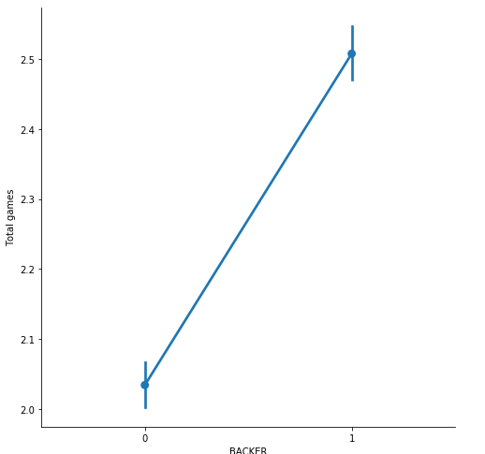
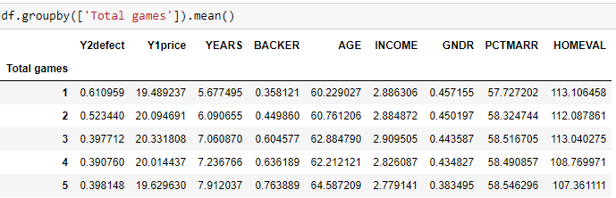
Data Visualization

Slide 9
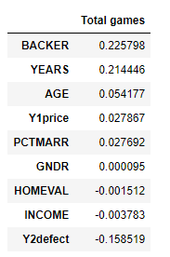
Data analysis
Values between 0 and 0.3 (0 and -0.3) indicate a weak positive (negative) linear relationship.
Values between 0.3 and 0.7 (-0.3 and -0.7) indicate a moderate positive (negative) linear relationship.
Values between 0.7 and 1.0 (-0.7 and -1.0) indicate a strong positive (negative) linear relationship.

Slide 10
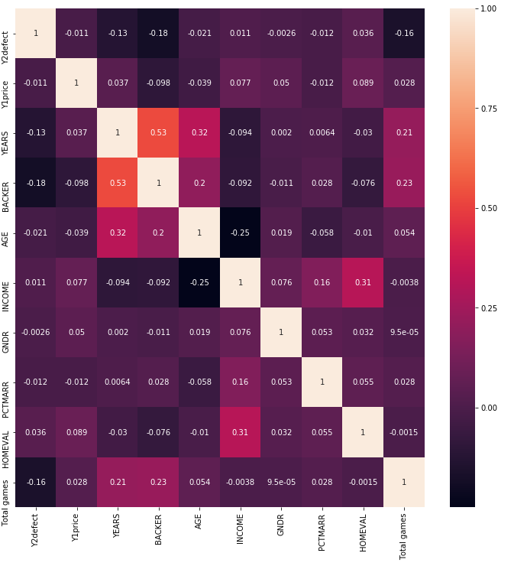
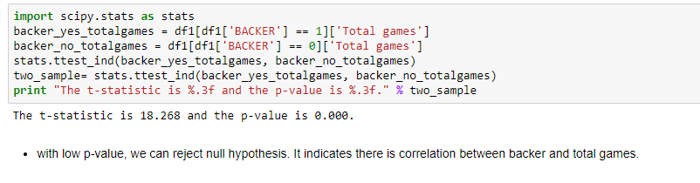
Data analysis

Slide 11
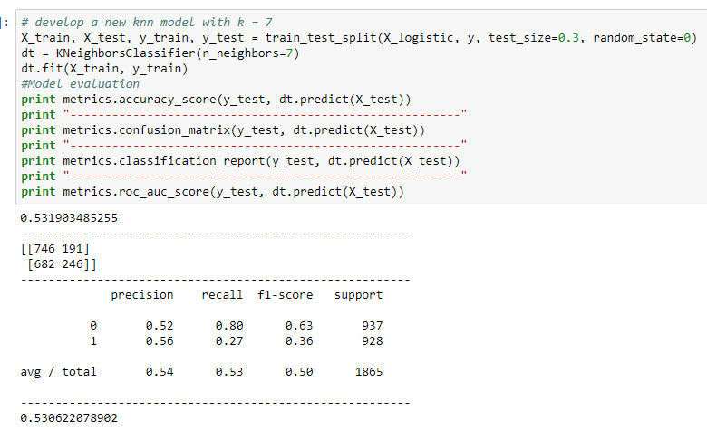
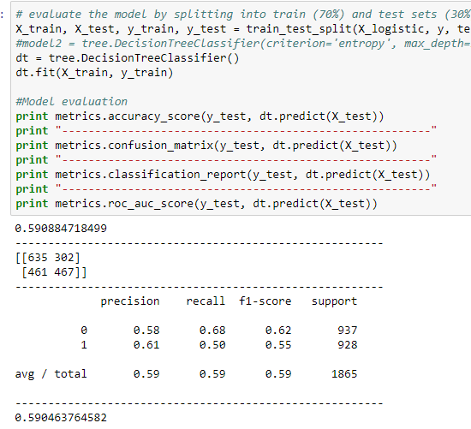
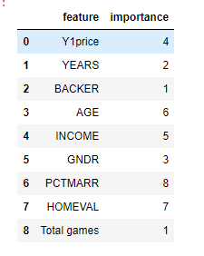
Model Selection

Slide 12
Conclusion
Member of Backer club has higher chance to buy more tickets in this dataset.
Years has a positive relation with total games which means more and more people decide to buy tickets.
Years and Backer has a highly related positive relation too.
Age might be another point that affect Member of Backer club because it has a positive correlation.

